Slide 1

ICD PROJECT
Members:
Josue Cobos Salvador
Enmanuel Magallanes Pinargote

Slide 2
Dataset descripcion
The dataset used contains information on Shippify deliveries. The available information is as follows:
ID of delivery: unique identifier.
Route ID of delivery: unique identifier of a route (contains more of tow deliveries).
Creation date: timestamp of creation delivery.
Delivery type: could be Flex or Slot.
Flex: are tasks that have a collection date, of the package(s), with a maximum time window of one hour from the specified time.
Slot: are those tasks that have a collection interval of more than one hour, maximum 12 hours.
Cost: money paid to the shipper.
Total size: size of delivery.
Distance: distance from pickup location to drop off location.
Pickup and drop off location: latitude and longitude for pickup and drop off.

Slide 3
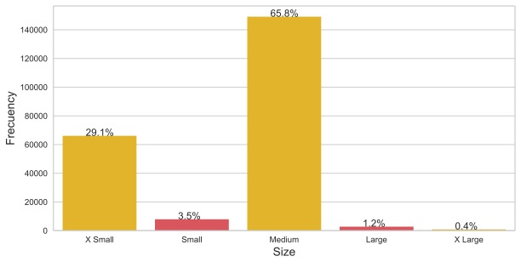
Size of deliveries

Slide 4
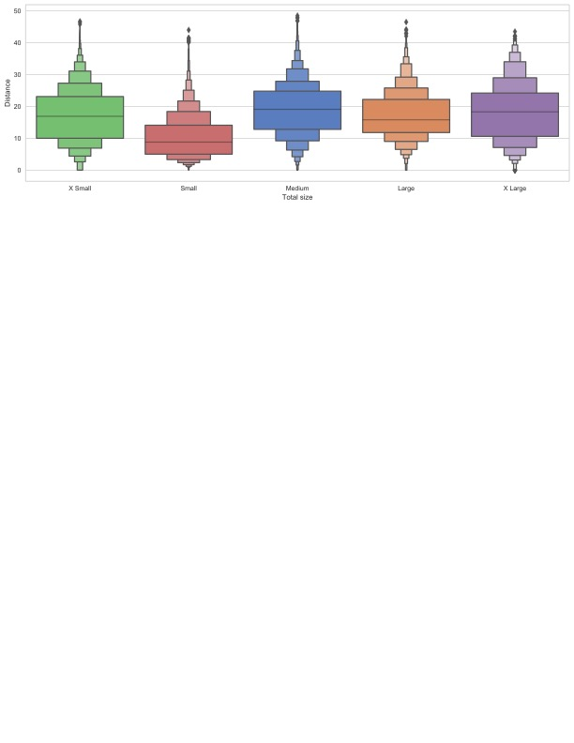
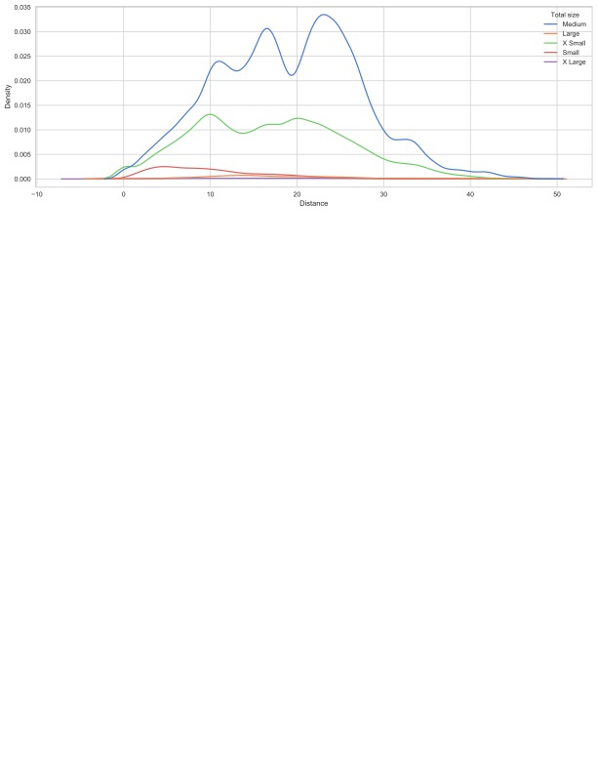
Size of deliveries

Slide 5
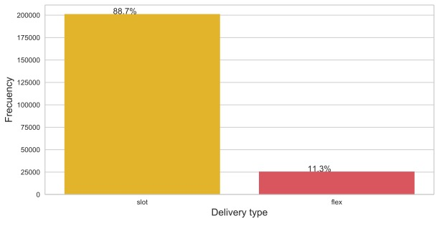
Delivery type

Slide 6
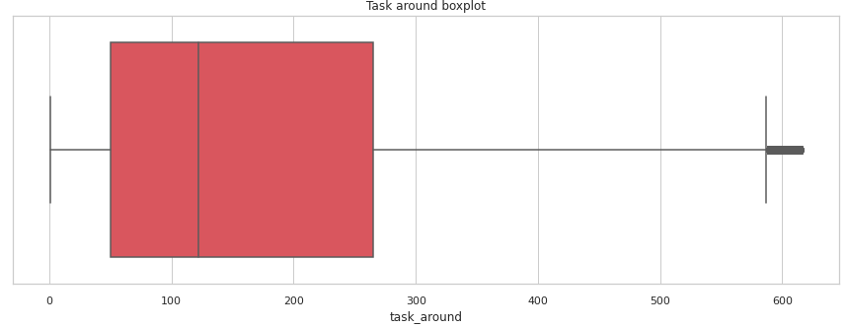
Task around

Slide 7
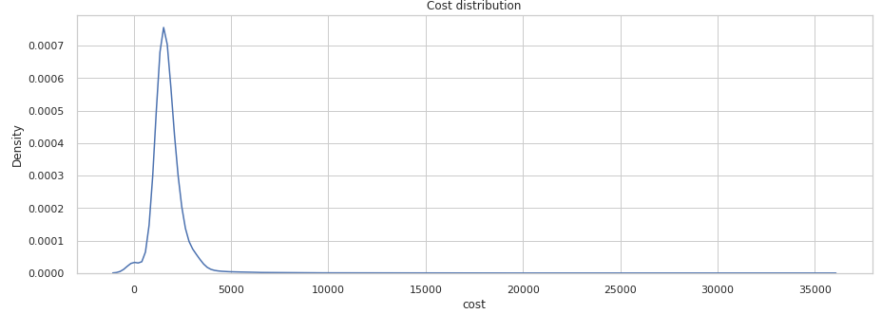
Cost

Slide 8
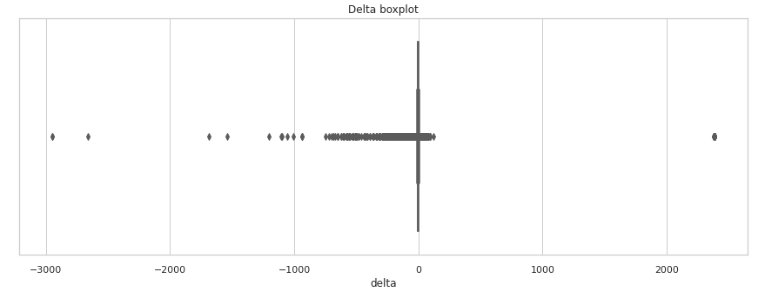
Delay

Slide 9
Delivery type

Slide 10
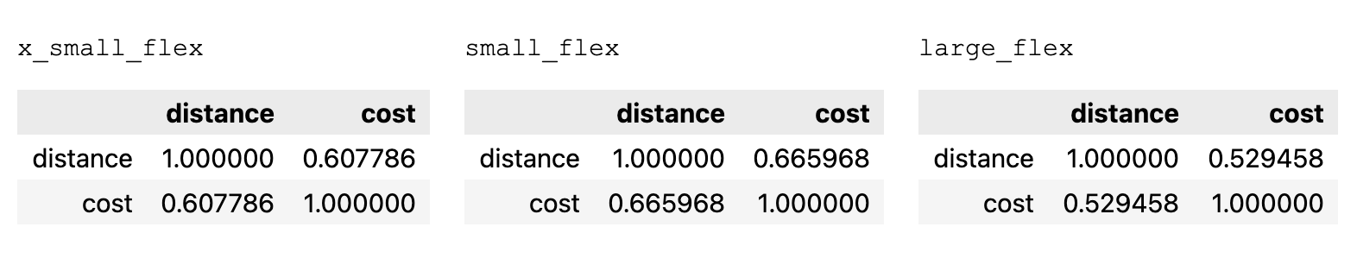
Correltion Distance vs Cost

Slide 11
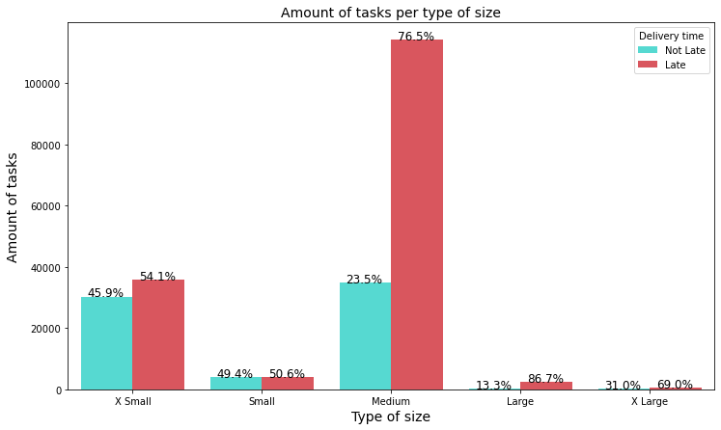
Is the total weight of packages a factor affecting the timeliness of deliveries?
In the graph we can see that there are more deliveries with size X Small and Medium than the others. However, what is important here is to analyze the percentage of tasks delivered on time and those that are not. There are no significant differences between Small and Small X-size tasks. In contrast, Medium, Large and X Large tasks have a significant difference in the percentage of on-time deliveries. This indicates that the size of deliverables affects on-time delivery when their size is equal to or larger than Medium.

Slide 12
Are tasks with fewer neighboring deliveries* taking longer to reach their delivery point?
To carry out this analysis we first have to determine what would be the time window (hours) and radius (kilometers) around a task to be used. For this we analyzed the distance and average time difference of a route in the delivery path, from the first package to the last one. The following results were obtained:
Mean time: 3.12 hours
Mean distance: 3.20 Km.
* We define neighboring deliveries as all those deliveries that are less than or equal to X Km away from the same and their delivery date is within T hours of the same.

Slide 13
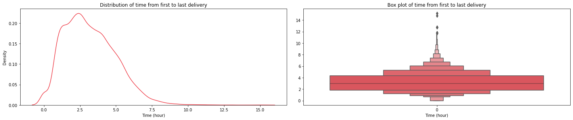
Mean time on drop off step
As we can see the scheduled time from the first delivery to the last delivery, on average, is 3.12 hours. This values will be our time window to use to determine the number of deliveries that exist around one.

Slide 14
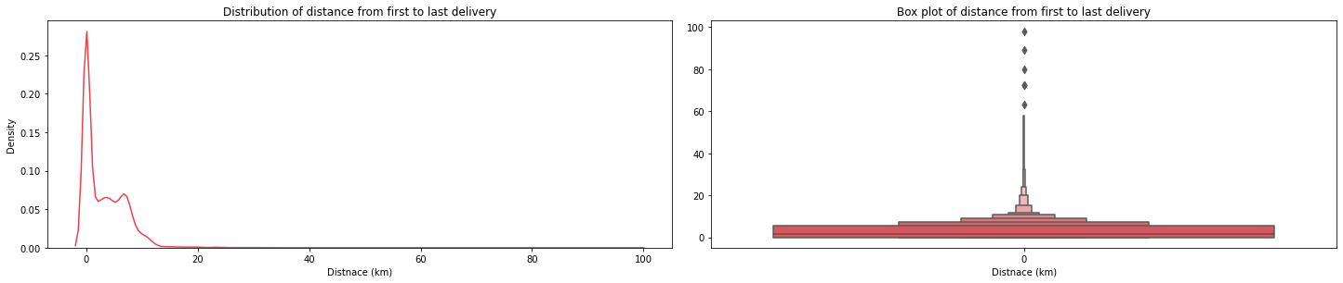
Mean distance on drop off step
As we can see the scheduled time from the first delivery to the last delivery, on average, is 3.12 hours. This values will be our time window to use to determine the number of deliveries that exist around one.

Slide 15
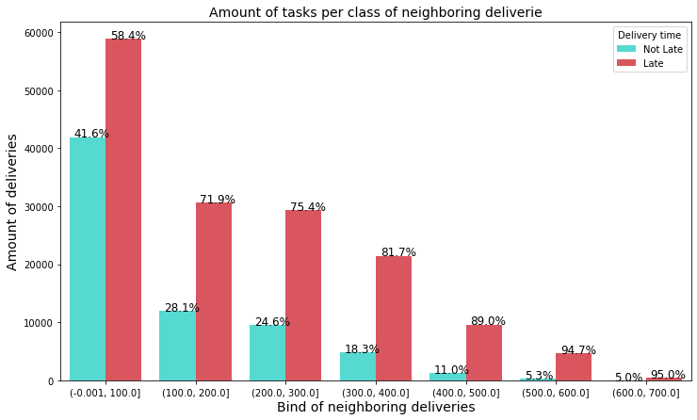
Responding to the question about neighboring deliveries
In the plot we can see that as the number of neighboring deliveries increases, the percentage of late deliveries also increases. This tells us that the higher the concentration or density of deliveries around you, the more likely it is that you will be late in reaching the final customer.

Slide 16
Neighboring delivery's location

Slide 17
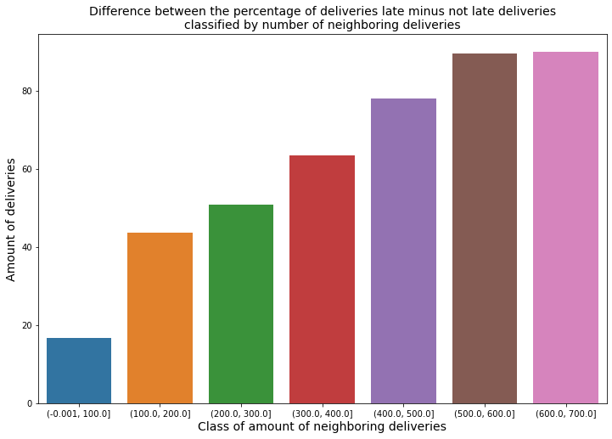
Plot of percentage differences
Here we can see more clearly how, as the number of neighboring deliveries increases, the difference between the percentage of overdue tasks minus those not overdue increases.

Slide 18
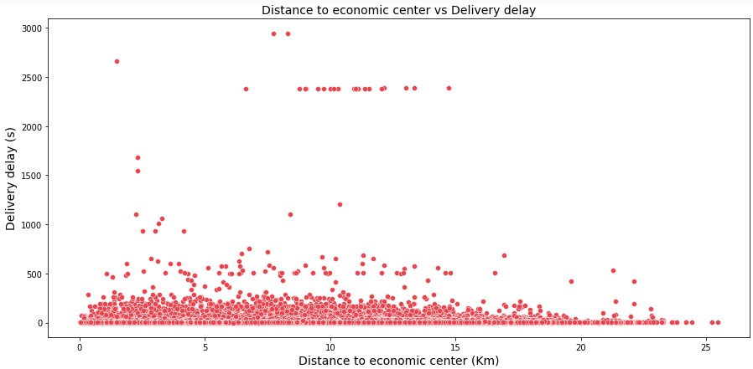
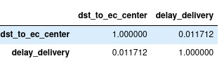
Correlation between delay and distance

Slide 19
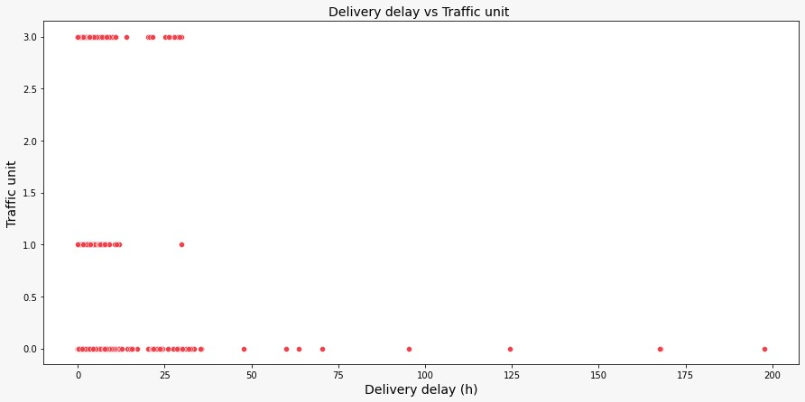
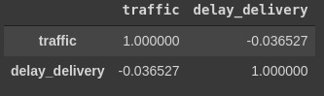
Correlation between delay and distance

Slide 20
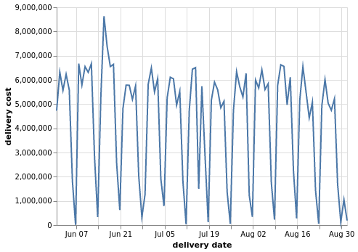
Cost vs date

Slide 21
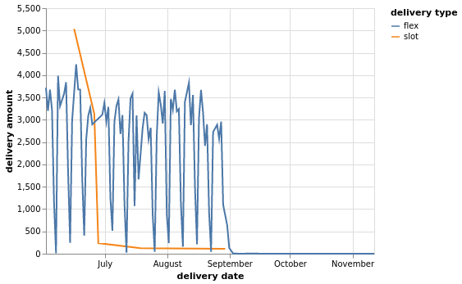
Delivery type amount vs date

Slide 22
Clustering (features analysis)

Slide 23
Clustering (features analysis)

Slide 24
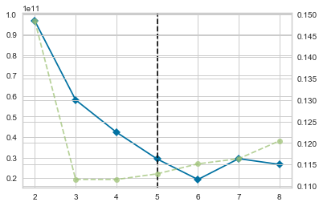
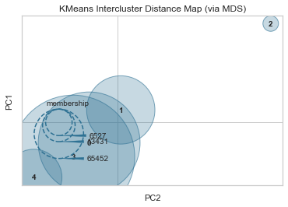
Clustering without standardization

Slide 25
Clustering without standardization

Slide 26
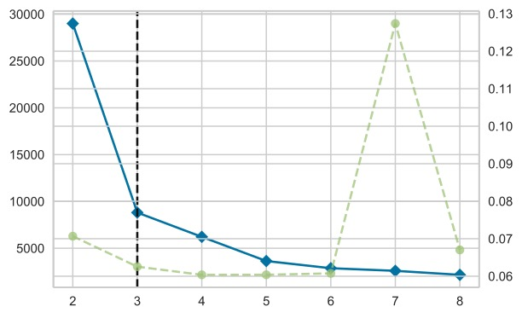
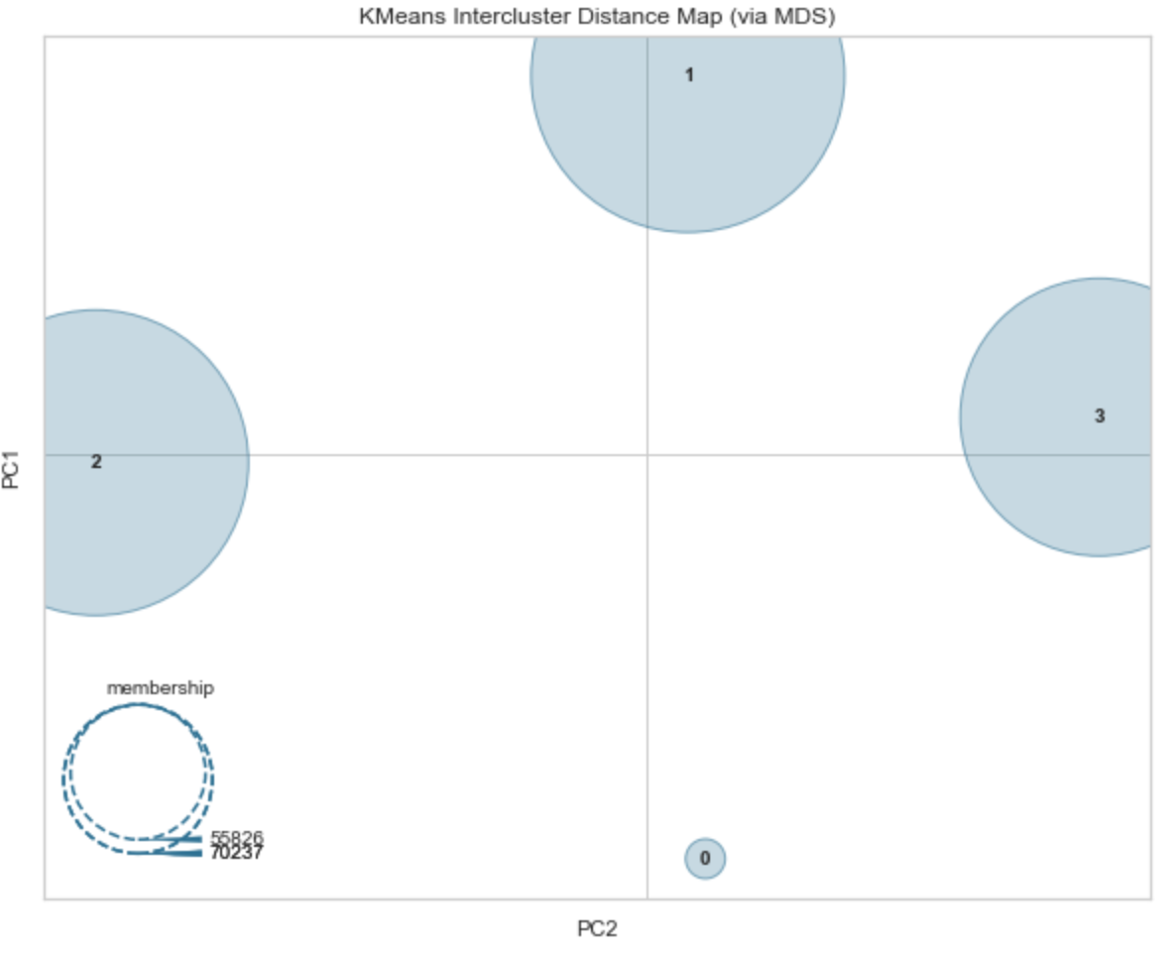
Clustering with standardization
Cluster | Population
Cluster 0 | 25518
Cluster 1 | 75247
Cluster 2 | 70237
Cluster 3 | 55826

Slide 27
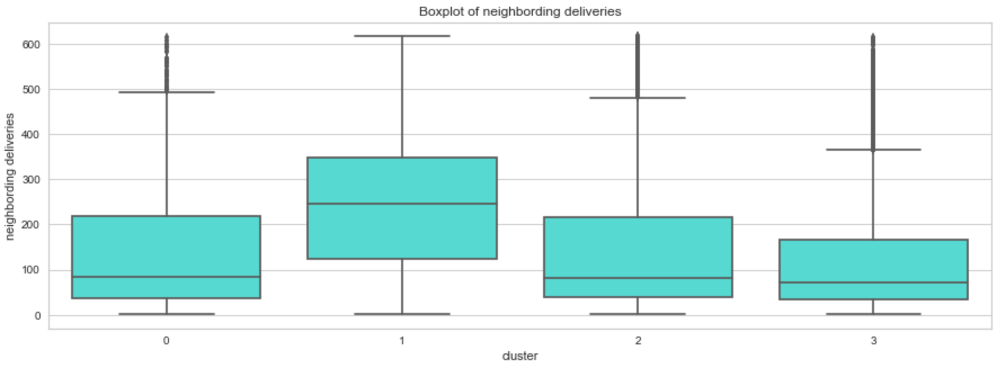
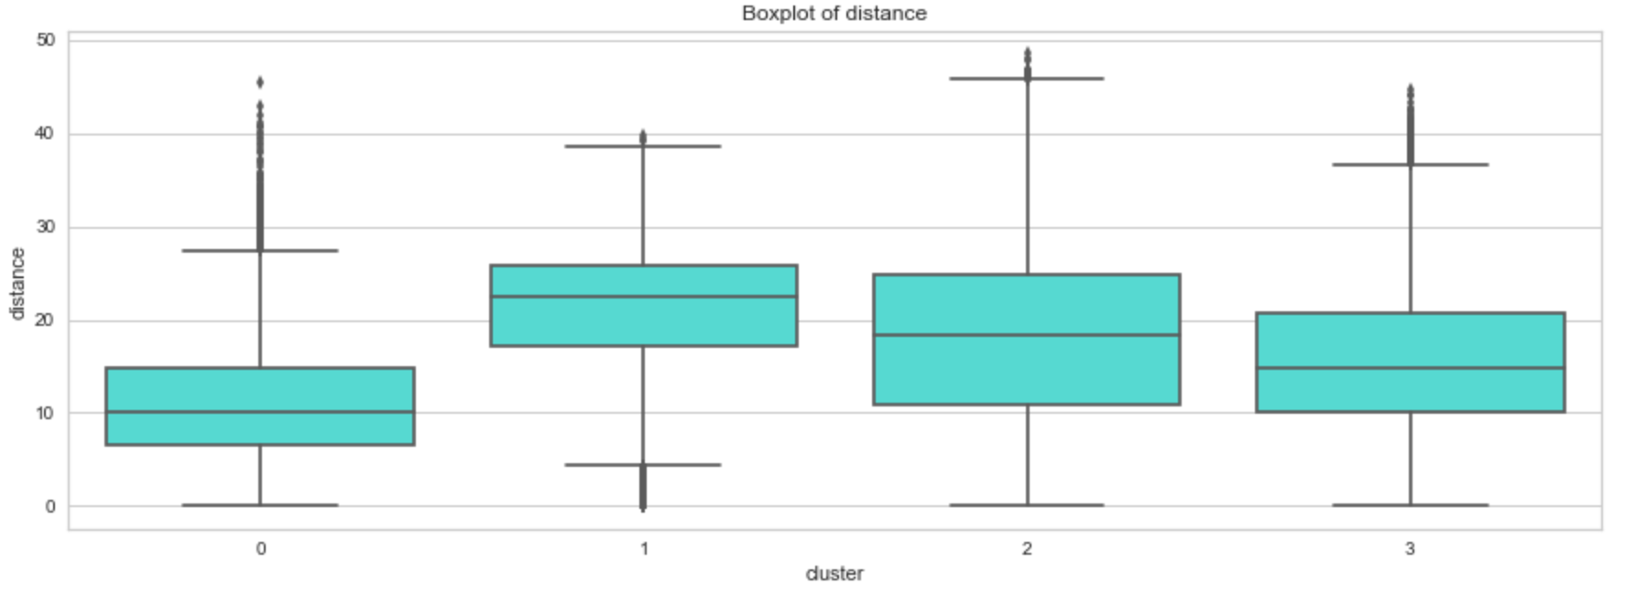
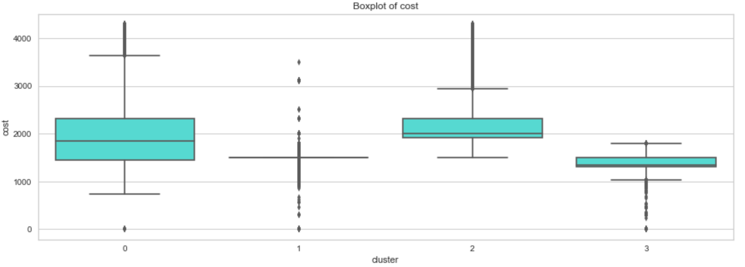
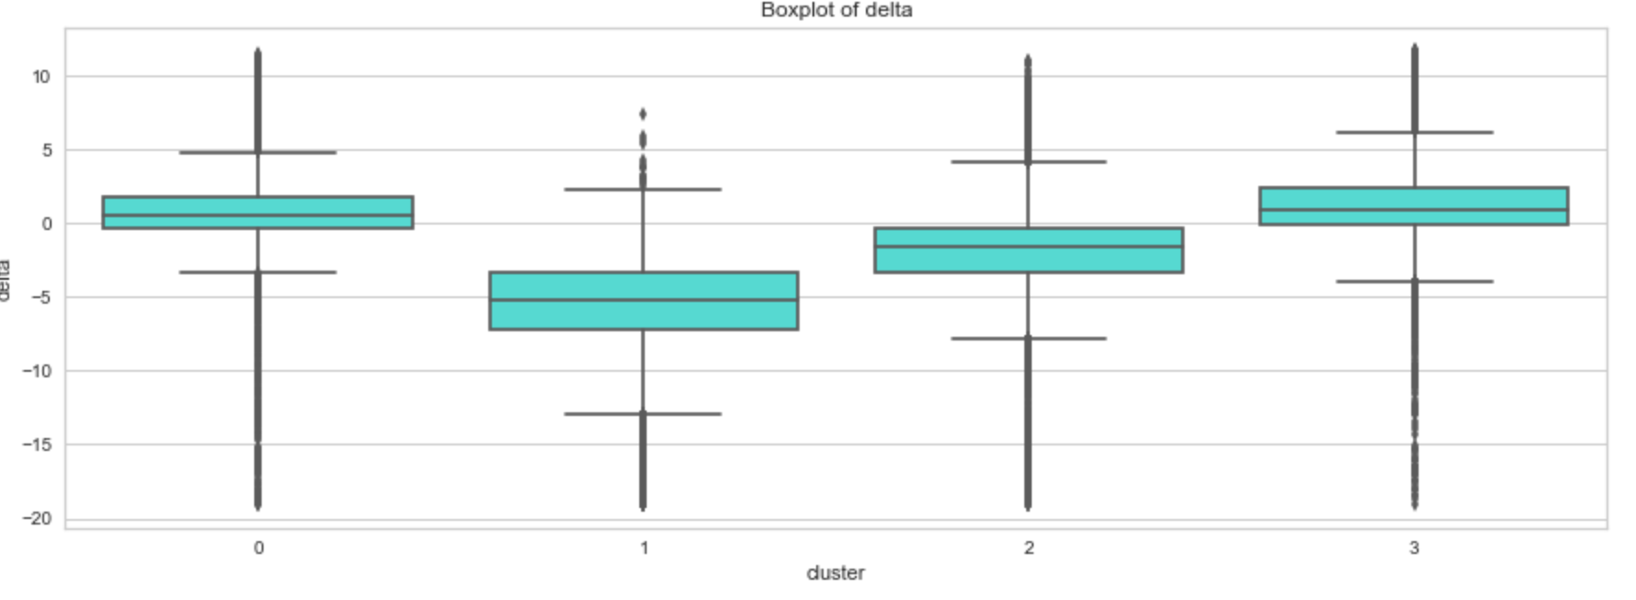
Clustering with standardization

Slide 28
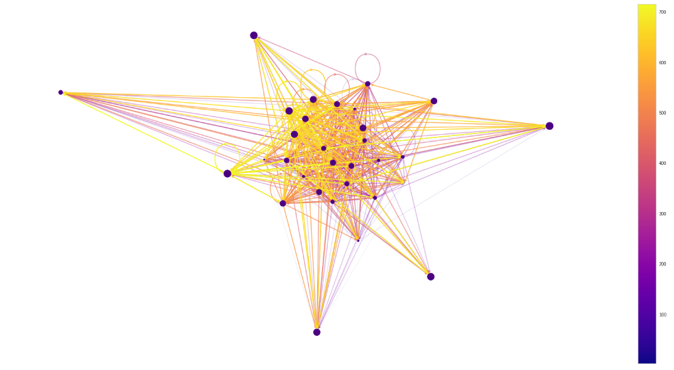
Social network analysis

Slide 29
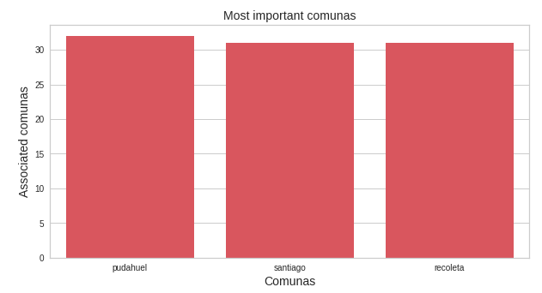
Important comunas: criteria A

Slide 30
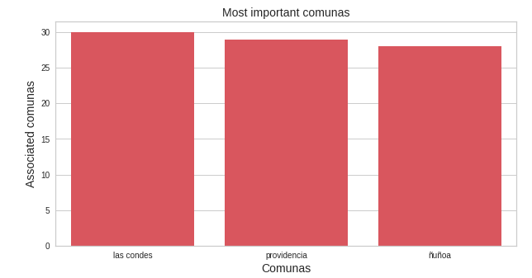
Important comunas: criteria B

